Slide 1
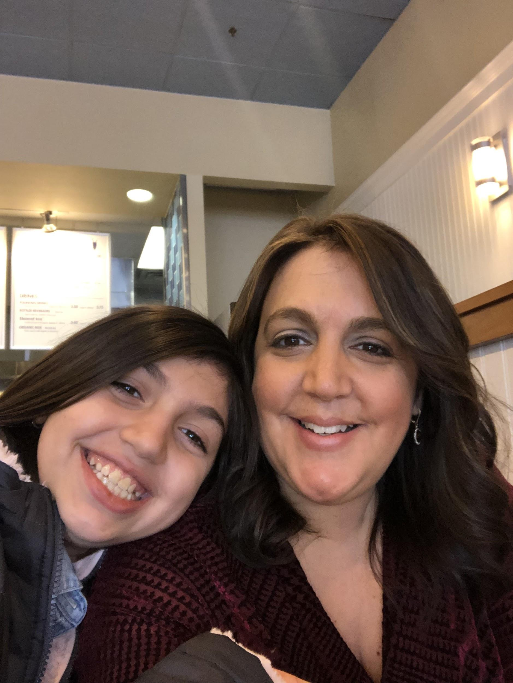
Ms. Librandi’s Virtual Mother’s Day Library
Happy Mother’s Day! Enjoy reading with your child!
READ and sing with Mom

